Slide 1
Personal Development
11th March 2015
SELVET @ Malta
Orlando Bonnici
Robert Buttigieg
Elysia Marie Farrugia

Slide 2
overview
Introduction
Relationship
Immediacy issues
Difficulties encountered
Groundwork
Units covered
Resources
Conclusion

Slide 3
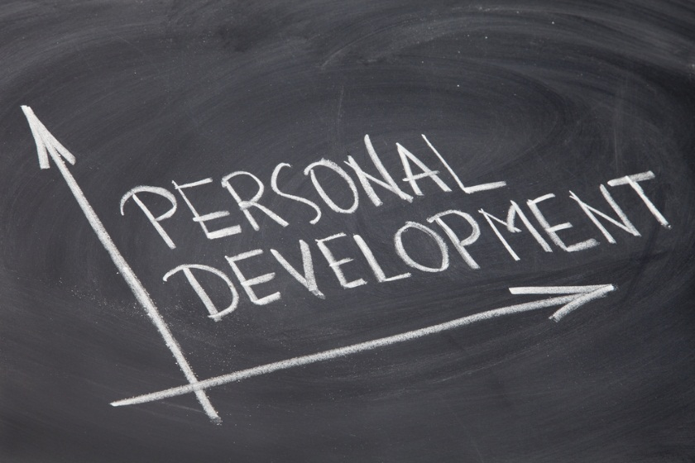
introduction
First introduced to MCAST in 2008
Compulsory at levels 1 – 3
Weekly sessions
Tailor-made

Slide 4
relationship
Students come from different schools and backgrounds
PD acts as a socialisation catalyst
Sessions based on activities & fun
Trust amongst the group and their lecturer will set the foundations for future disclosure

Slide 5
immediacy issues
Disclosure of personal experiences, beliefs, ideas and thoughts
Part/whole session is side-lined
Improvisation – from experience & training
Major focus on emotions

Slide 6
difficulties encountered
Superficial relationship between lecturer and/or students
Language/Communication barriers
School transition complications such as mingling with opposite gender

Slide 7
groundwork
Promotion of group work
Addressing trust issues & insecurities
Develop a sense of responsibility
Dissemination of general knowledge

Slide 8
Communication
unit 1
Students will learn how to properly communicate with themselves and with others in different circumstances and also how to give and take feedback.
units covered

Slide 9
Working with Others
unit 2
Students will learn to work better in teams.
units covered

Slide 10
Problem Solving
unit 3
Students will be able to understand some problems in their daily life and how to tackle these different issues in a healthy and constructive way.
units covered

Slide 11
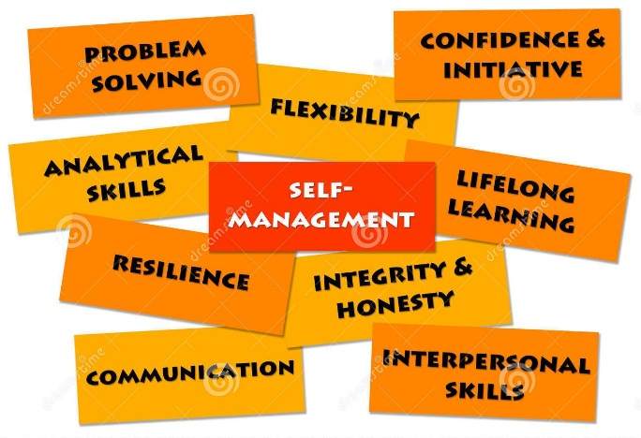
Self-Management
unit 4
Understand how to control different social situations and learn when to say no to particular dangerous habits which they might encounter in their life.
units covered

Slide 12
Civic Skills
unit 5
Students will be introduced to a number of civic skills which will make them better citizens and better persons.
units covered

Slide 13
resources
Variety of resources accumulated through different sources
Different teaching styles majorly addressing hands-on experience
Guest/professional speakers
Utilisation of media & real life scenarios

Slide 14
conclusion
PD being proposed also for higher level students at MCAST
Restructuring of the whole programme in order to increase its effectiveness

