Slide 1
Social Skills Training Program
University of Szeged
Graduate School of Educational Sciences
Ph.D. student : Dorina Tápai (dorinatapai@msn.com)
Supervisor: Anikó Zsolnai Dr. habil
Budapest, November 14, 2013

Slide 2
Introduction
Schools like a „micro society”
Social skills as a means to promote children’s well-being (Segrin & Taylor, 2007), and academic achievement (Chen, 2006, Gresham et al., 2004)
Social and emotional factors have influences on learning (Wang, Haertel and Walberg, 1997)
Schools have an important role in this area
Major socializing institution in society (Gresham, 2000, Zsolnai, Kasik, & Lesznyák, 2008)
Changes in the life of the family (Tóth & Kasik, 2010)

Slide 3
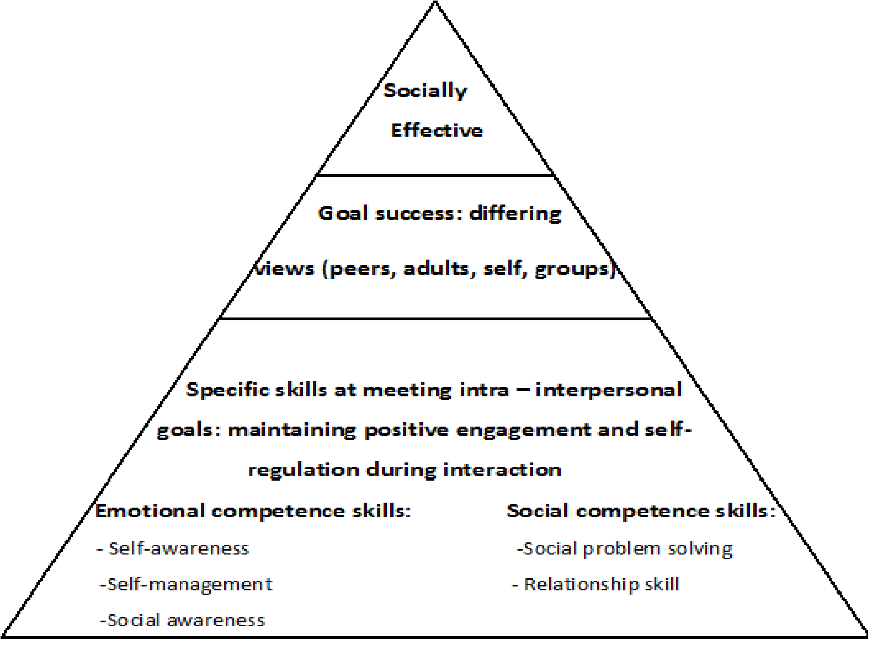
Social and emotional competence
Multidimensional construct and it includes social skills, adaptive behaviors and peer relationship (Gresham, 1997)
Cognitive, emotional and
integrative models
Denham’s (2005)
framework for social
and emotional
competence

Slide 4
Social and Emotional Skills Training
Mental disorders with little or no function in social skills (Shepard, 2003)
Cognitive, emotional and integrative orientation (Zsolnai, 2012)
Fundamental principles of the training programs:
Social skills are learned behaviors (Buda, 2003, Chen,2006)
Natural settings and situations in the development (Frosh, 2003)
Various methodology: modelling, role playing, problem-solving, discussing stories and feedback (Shepard, 2003, Zsolnai, 2003)
Period: last for a period of 10 weeks, but the majority of them are longer (Frosh, 2003, Greenberg et al, 2003)

Slide 5
Social skills training in Hungary
Few social skills programs
Zsolnai and Konta (2002)
- Prevention orientated, 2 years school-based program
- Verbal and non-verbal communication, cooperation,
tolerance
- Substantial improvement of the mentioned skills

Slide 6
SOCIAL SKILLS TRAINING PROGRAM FOR ADOLESCENTS
Eva Szabo (2012)
Ten-week training program
Focus on the following elements:
Self awareness and self confidence
Communication skills
Conflict resolution and problem solving

Slide 7
Social skills training protocol
Training Stages | Training Objectives
One | Expression of group goals, introductions rules
Two | Perception of own and others’ properties
Three | Self awareness
Four | Highlight individual strengths
Five | Recognize the pupil’s own and others’ emotions
Six | The ability to say no
Seven | Understanding the difference between strong, aggressive and passive behaviours
Eight | Improve anger management
Nine | Estimation of assertive levels
Ten | Farewell to the group

Slide 8
Participants
3 schools from Szeged and 3 schools from small villages
Experimental group (n=50)
Control group (n=94)
12-18 years, the mean age was 14,90 years (standard deviation of 1,23 years)
82 female, 62 male

Slide 9
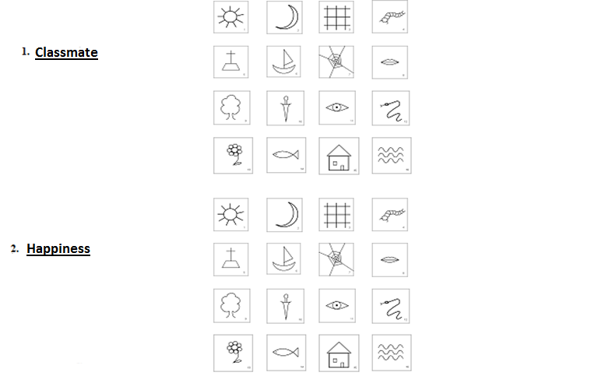
Measures
Semantic Selection Test – SST (Filip, Urbánek & Lukavsky, 2010, Szabó, 2010)
Notes:
The subject has to choose 8 pictures (out of 16 pictures) that he/she feels most relevant to a given concept. The test gives an opportunity to explore the place of the target words (‚Me’ , ‚Classmate’, ‚Expressing feelings’, ‚Say no’ and ‚Being Furious’) in a two-dimensional semantic area. The two-dimension was: happiness and fear.

Slide 10
Measures
Semantic Selection Test – SST (Filip, Urbánek & Lukavsky, 2010, Szabó, 2010)
Assessing Emotions Scale (Nagy, 2010)
Anger Expression Scale (Oláh, 2005)

Slide 11
Hypotheses of the project
The pupils who participate in the program will:
Score higher in the Assessing Emotions Scale
Have lower score in the Anger Expression Scale
Changes their associations in the Semantic Selection Test

Slide 12
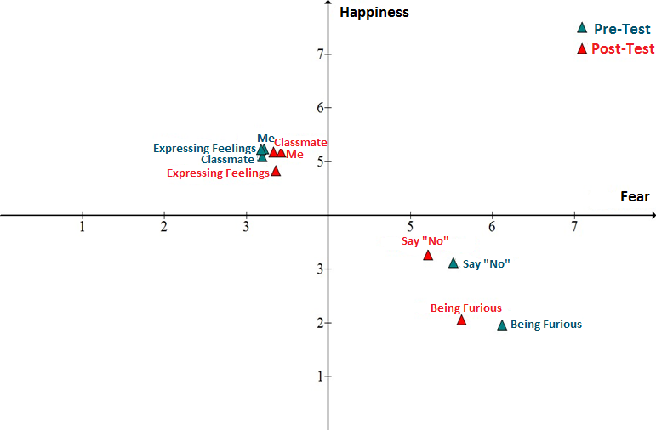
Semantic Selection Test
Notes:
The location of the target words along the axis. The cordination of the target words determine the coincidence with the words happiness/fear. For example in the pre-test the ‚classmate’ words coincidence with ‚happiness’ is 5,10. While ‚classmate’ coincidence with ‚fear’ is 3,20. So that’s why the coordination of ‚classmete’ is: 3,20;5,10.

Slide 13
Assessing Emotions Scale
Subscales | Exprerimental group (N=50)
 | Pre-Test |  | Post-Test
 | Mean | Standard Deviation | Mean | Standard Deviation
Appraisal of Emotions in Self (2 item) (t(48)=-2,13, p=0,038) | 7,36 | 1,86 | 7,91 | 1,55
Appraisal of Emotions in Others (7 item) | 25,52 | 4,31 | 25,34 | 4,23
Emotional Expression (2 item) | 6,66 | 1,92 | 6,75 | 1,86
Emotional Regulation of the Self (8 item) | 26,80 | 4,81 | 26,97 | 4,69
Emotional Regulation of Others (5 item) | 19,23 | 3,47 | 18,82 | 3,17
Utilization of Emotions for Problem Solving(4 item) | 13,85 | 2,59 | 14,19 | 2,61
EQ (28 item) | 100,5 | 12,50 | 100,2 | 12,62

Slide 14
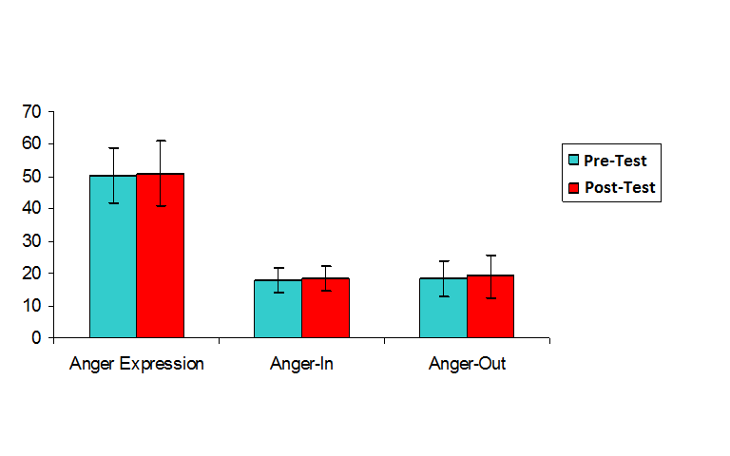
Anger Expression Scale
N=44, p>0,227

Slide 15
Discussion
The resaults prove the primary hypothesis at a lower level
The applied measurements are not sensitive enough
10 sessions are not enough for developping these skills
Methodological difficulties during the training program in the schools
The role of the school psychologists in the field of the social development

Slide 16
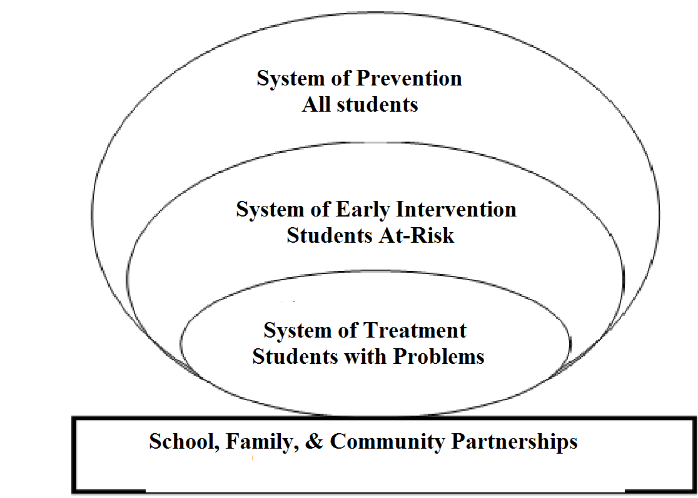
Social and Emotional Learning (SEL)
„The capacity to recognize and manage emotions, solve problems effectively, and establish positive relaionships with others, competencies that clearly are esstial for all students” (Zins & Elias, 2006)
System of support
System of Prevention, Intervention,
Treatment
Key competencies:
1. Self-awareness
2. Social awareness
3. Responsible decision making
4. Self-management
5. Relationship skills

Slide 17
Overview of the present research projet
Social and emotional skills training program for childrens
Involve parents and teachers
Experimental group and control group
Pre-test and post-test assessment
Main issues: - Self- and social awareness (self-efficacy,
identification and recognition of one’s own
emotions, empathy, respect for others)
- Relationship skills (cooperation,
providing, communication)
Complex test assessment

Slide 18
Thank you for your attention!
Dorina Tápai (dorinatapai@gmail.com)
University of Szeged,
Graduate School of Educational Sciences

