Slide 1
Social Emotional Learning
In the Community

Slide 2
Creating Awareness
PSD at school
School Counselling
Youth work
Associations
Local Councils

Slide 3
Training Youth Workers
Youth Work Core Skills I - YTH 1009
Intra/interpersonal Skills
e.g self awareness & self esteem
communication etc
Youth Work Core Skills II - YTH 1010
basic helping skills
(Limitations and when to refer)

Slide 4
Other Courses promoting SEL
YTH5003 - The Sociology of Youth
YTH2008 - Sociology of Youth and the Community - An Introduction
YTH2019 – Young People and Community Development
YTH2020 - Young People with Disability
YTH1011 - Young People with Minority Experiences

Slide 5
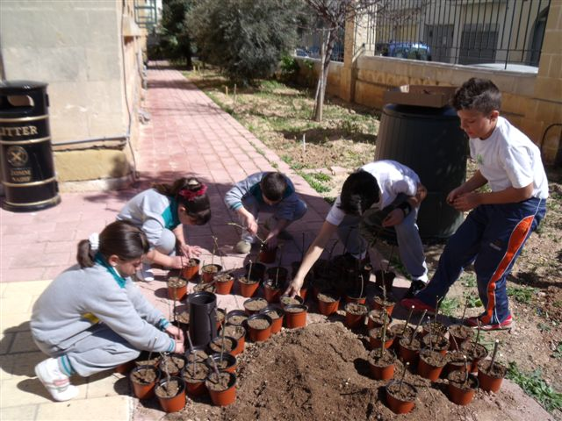
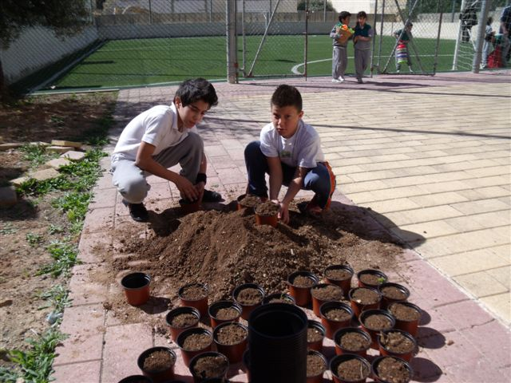
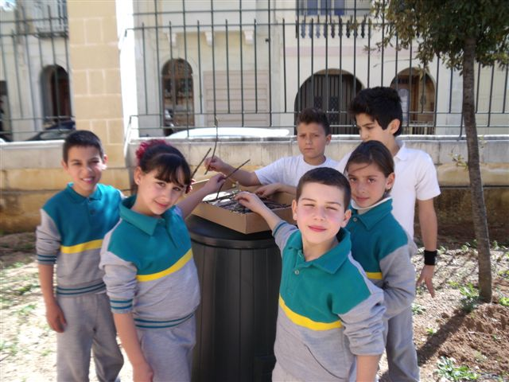
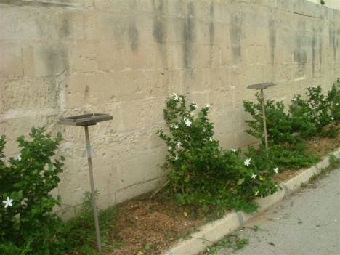
School Link with Local Councils

Slide 6
Peer Leadership Courses
Weekend live-in courses for students in Form 4 organised by:
Caritas Malta
Sedqa
Based on experiential methodology

Slide 7
Counselling Associations
Counselling Association – MACP
How counselling as both a process and a profession can promote wellbeing on a global basis
International Association for Counselling – IAC
Conference in Verona in September – The
Counselling Profession : Building Bridges towards Wellbeing
MAPA – Malta Adlerian Psychology Association

Slide 8
KEEPING THE FAMILY IN PERSPECTIVE
Thinking Child Thinking Family

Slide 9
Other Associations
National Council of Women
Courses
National Commission for the Promotion of Equality – NCPE
Capacity Training
Local Councils
Parenting skills
Religious Organisations

Slide 10
Skills for Public Speakers

Slide 11
Parents and the Media – National Council of Women (NCW)

Slide 12
National Commission for the promotion of Equality - NCPE

Slide 13
Putting into practice in youth clubs around Malta
Sessions which are experiential and encourage among other things:
Reflective thinking (processing)
Higher self awareness especially re. emotions
Sensitivity to others
Integration of skills in day-to-day living

Slide 14
Agenzija Zghazagh
Youth activity centres at Villa Psaigon and Marsaxlokk
First youth cafes in Malta at Qawra, Msida, Cottonera and Valletta
First youth hubs in Malta at Santa Venera and MCAST
The Youth Information One Stop Shop in Valletta
The Youth Stop in Valletta
An interactive web portal Youth Information Malta
Online support services Kellimni.com

Slide 15
Youth Empowerment Programme
Capacity building needed to partake in society
Formal and informal decision-making
Active agents for development and social change
Given tools to understand issues influencing quality of life
Be empowered to take action
Become motivated and take control of their lives
Develop further own learning and resourcefulness
Improve employability skills

Slide 16
Social and Emotional learning
Self-Awareness
Self-Management
Social Awareness
Relationship Skills
Responsible Decision-Making

Slide 17
Commissioner for Children
Promotes the rights of children, in line with the United Nations Convention on the Rights of the Child, which Malta signed in 1990.
Provides education and awareness-raising in order to fulfill its function and in enhancing SEL.

Slide 18
The president’s Secret Garden Children’s Hub
Self expression using sign language & dance
Healthy Eating – Fonzu l-Fenek
Educational – Read With Me
Nurture – animated stories focusing on values & messages through discussion
Expose – activities to encourage attention to environment & recycling.

Slide 19
Parenting Skills
Growing need
Parents expected to know how to bring up children
Experience shows that skills are needed
to build healthy relationships with children where there is open communication
Many problems arise because of lack of emotional developement e.g no idea of empathy

Slide 20
Thank you
Maud Muscat

